Slide 1
Current Process
DA enters Variable Pay spreadsheet by cross checking approved ticket, Job Bonus Summary Sheet
Employee submits OVPP
Crew goes on location to Complete the job
Manager approves OVPP
Start
DA prints employee statement
DA Enters OVPP
Dispatch takes in client’s job request
Supervisor fill in job information
Employee hands in Job Summary and meal allowance
Dispatch creates Call Sheet for the job
DA does cross checking
Supervisor send Job Package to server
Manager approves Variable Pay spreadsheet
Dispatch schedule crew, equipment & product for the job
Manager approves Job Package
Manager/DA sends the approved VP spreadsheet to Payroll Admin
Dispatch calls out crew
Manager prints out Job Bonus sheet and makes correction for approval
Payroll Admin export to ADP

Slide 2
Challenges & Difficulties
Data Accuracy
Supervisor putting the wrong information and waiting for a new work order or a resign of ticket
Data collected in eService doesn’t match current VP practice
Handwriting information on printout
Supervisor doesn’t enter on/off location data correctly since it is not used for pay calculation.
Repetitive Data Entry
Duplicate information like ticket number, company name, date, revenue, etc.
File locked among districts
If there are employees from another district, and that district VP spreadsheet is in use
Cross checking information widely
On one ticket there is lot to watch out. E.g., employee district, West or Each, working province, primary or remedial, job employees performed, if they receive crew efficiency, check for stand by, etc.
Finding information for a missed entry, may have to look through ticket package, call sheet, MTSs, Safety Meeting, Driver logs, etc.
Cross checking payment with employee submitted job summary.
Ticket original copy delays
Especially in winter as employees are up in camp or on a project rig.
Combined tickets

Slide 3
Definitions – Key Entities
Work Assignment: Currently we capture cementing/remedial jobs assigned to crew and product hauls needed. Work assignment data is recorded in Call Sheet.
Work Activity: The working fact details which fulfill work assignments. Formerly it was called Job Bonus.
Work Type: The indicator of work is performed.
Pay Entry: The payment for the work performed according to variable pay rules.
Pay Type: The indicator of a variable pay rule.
Pay Period: The recurring length of time which variable pay is calculated and paid.
Payroll Summary: The summary list of all variable pays to employees’ work activities within one pay period.
Pay period Summary: The summary list of total variable payment for each pay period.

Slide 4
Definitions – Details of Work Activity
Employee Name:
Service Line:
Job Position:
Question:
Work Type:
District:
Start Time:
End Time:
Working Hours. Length of the time for the job. E.g., Cementing Service hours is from On Location Time to Off Location Time.
Standby Hours:
One-way travel time: Crew travel time from camp to well site location
Two-way travel time: The total time that the crew set out from camp and return to camp.
One-way travel distance: Crew travel time from camp to well site location.
Two-way travel distance: The total distance that the crew set out from map and return.

Slide 5
Definition – Detail of Variable Pay
Hours of Service, A.K.A. Length of the time for the job: From On Location Time to Off Location Time.
Variable Pay Area: Area the job is completed (east or west of the 5th meridian)
Question: Is it determined by Service Point or LSD?
Variable Pay Position: job position performed on job not the HR position held.
Job Revenue: Approved ticket revenue.
One-way travel time: Crew travel from camp to well site location
Two-way travel time: The total time that the crew set out from camp and return to camp.
One-way travel distance: Crew travel from camp to well site location.
Two-way travel distance: The total distance that the crew set out from map and returned.
Job Date: The date of crew is on location.
Work Assignment:
Work Activity:

Slide 6
Role - Dispatch
When dispatch schedule a job, crews must be assigned from Rig Board. The crew information will be populated in Call Sheet

Slide 7
Role – Field Supervisor
Supervisor needs to toggle "Is Multi-Well job?"
When supervisor creates a job package from a call sheet, all on site crew members will be populated in Work Activities section. These information are carried over from Call Sheet. Includes
Employee Name
Service Line
Job Position
Work Type (default as job type)
Supervisor needs to fill in following before sending job package to server
Start Time (default as On Location Time)
End Time (default as Off Location Time)
Standby Hours
Two Way Travel Time
Two Way Travel Distance
Description (if applicable).
Supervisor needs to add any work activities beyond job type itself. e.g. Self Load.

Slide 8
Role – District Manger
-Manager needs to approve billing information of job ticket.
-Manager needs to toggle if the job was completed or failed or incomplete?
-Manger needs to toggle if a job meets Crew Efficiency Bonus criteria.
-Manager needs to verify following items, update and approve each work activity related to a job.
Start/End Time, Length Time will be automatically calculated
Standby hours
Job Position
Travel Distance
Travel Time
Toggle "Is Extended Travel?" based on Travel Distance and Travel Time
Description, adding notes if needed
Manager can approve all work activities related to one single job at one time. Pay entry generation process will be triggered.
Manager can approve individual work activity added by DA or modified by DA. Pay entry generation process will be triggered.
Manager can approve DA entered pay entry or modified pay entry.
Manager can approve Pay Summary.

Slide 9
Role – District Admin
DA can enter work activity based on submitted evidence, the manager approval process will be triggered.
DA can modify approved but not paid work activity, the manager approval process will be triggered.
DA can review pay entry and modify pay entry if system calculation is not correct. Manager approval process will be triggered.
DA can enter pay entry for system not supported pay type upon evidence. Manger approval process will be triggered.
DA can trigger period cut off to generate pay summaries. Once the pay period is cut off, all approved work activity and pay entries are locked as PAID, modification and deletion are not allowed.
DA can review pay summary.

Slide 10
Role – Payroll Admin
- Payroll admin can export pay period summary

Slide 11
DA
Enter
Variable Pay Information Flow
Pay
Entry
DA
Enter
Manager
Approve
Work
Assignment
Work
Activity
Approved Work Activity
Approved Pay Entry
Pay
Summary
Approved Pay
Summary
Pay Period Summary
Supervisor
Enter
Manager Approve
Pay Calculation
Pay Period
Cut Off
Manager Approve
Export
Pay
Rules
Pay
Period
Manual Process
Auto
Process
Data

Slide 12
Solution in Components
Fact Acquisition
& Approval
Pay Calculation
& Approval
Pay Review and aggregation
Payroll Export
Standardize work activity structure to satisfy the requirement for pay calculation
Re-purpose job bonus section to work activity, it can be converted to work activity after manager approval
All OVPP in future needs to have work activity generated from ultimate source.
Work activity can be entered directly with approval needed.
Work activity is not editable after approved.
Rule based pay calculation based on work activity.
Pay Entry is per employee, pay type, per work activity. One work activity may generate multiple pay entries upon the calculation rules.
Pay Entry generated with reference to work activity.
Pay Entry can be entered directly with approval needed.
Pay Entry can be re-generated from work activity while the pay period is open.
Pay Entry is not editable if it is generated from work activity or approved manual entry
Pay period cut off will generate pay summary for each employee for pay entries.
Pay statement can be printed from pay summary.
Pay period can be re-open and re-cut. Pay summary will be re-generated
Pay summaries can be exported to ADP import format.
Once the import is done, pay period will be locked.

Slide 13
Work Assignment (Dispatch Process)
Start
Assign Crew to the job
Crew Assignment
Take in Client Job Request
Schedule Equipment
Equipment Haul
Call Sheet: Unit & Personnel Section
Create Call Sheet for the job
Schedule Product
Product Haul
Organize Crew
Call Out Crew for the Job
Work Assignment Includes:
Employee Name
Service Line
Work Type (Cementing Job, Product Haul, etc.)
Work Description
Job Operation Process

Slide 14
Call Sheet
Work Assignment
Job Operation Process (Work Activity)
Crew is called
Create Job Package from Call Sheet
Job Package
Job Preparation
Perform job
Drive to Location
Enter job information
Work Activities
(Formerly Job Bonus Section)
Arrive on Location
Enter onsite unplanned work activities
Work Activity Includes:
Employee Name
Work Type
Job Position
Service Line
Start Time
End Time
Travel Time
Travel Distance
Work Description
Job Identity (optional)
Job Date (optional)
Send Job Package to Server
Post Job Process

Slide 15
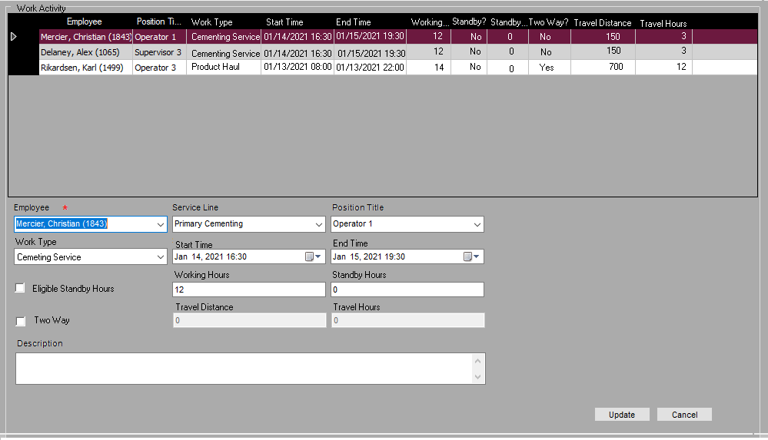
Employees’ work activities are pre-populated from work assignments in call sheet. Supervisor fills in employees’ the facts happen after the activity is performed. Supervisor also can enter work activity assigned on site or not in call sheet.

Slide 16
Post Process (Approved Work Activity)
Manual entered Work Activities
Job Package is received on server
DA Enter Work Activity From other source
Job Package
Manager approve billing information
Submitted Work Activities
Manager approve work activities in job package
Approved Work Activities
Manager Approve Work Activity
Manager determine if crew efficiency or Multiple Well Project
Job Package is Approved
Approved Job Package
Variable Pay Process

Slide 17
Manager can correct the facts within job approval process. The work activities in job packages are approved in batch once the job package is approved.

Slide 18
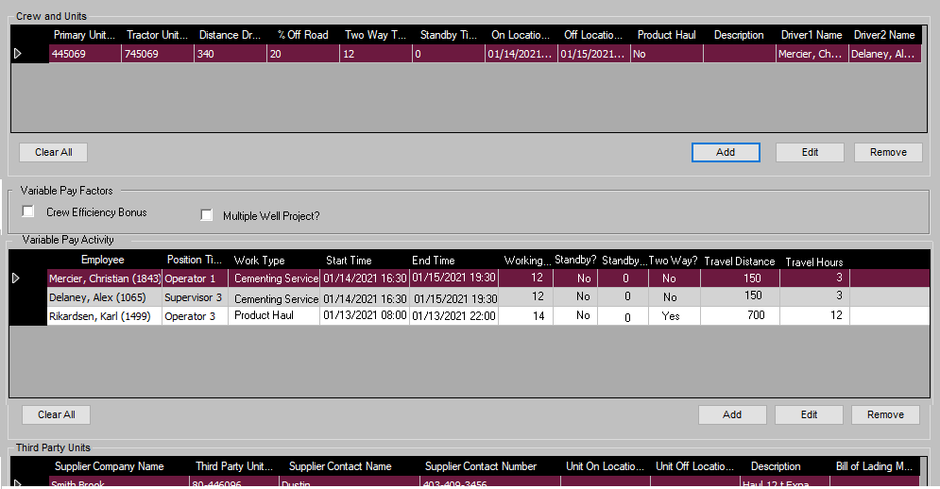

Slide 19
Work Activity Online Interface
Add
Modify
Approve
Delete
Filters: District:
Brooks
Service Line:
Primary
Employee:
Mercier, Christian
 | Employee Name | Ticket # | Service Line | Position | Work Type | Start Time | End Time | Working Hours | Standby? | Standby Hours | Two Way? | Travel Distance | Travel Hours | Status
 | Mercier, Christian | 463953 | Primary | Operator 1 | Cementing | 01/14/2021 16:30 | 01/15/2021 16:30 | 12 | No | 0 | No | 0 | 0 | Approved
Once a job package is approved, all work activities will be available on the Work Activity Online Interface. The work activities in job package will be locked. Further changes must be made in Work Activity Online Interface, all change history will be saved in database.
We also allow DA to enter work activity submitted from field employee. The entered work activity can be approved by manager case by case.
Approved work activity can be modified by DA, the manager approval process will be triggered.
Work activity can be deleted by DA, the manager approval process will be triggered.
If the pay period is cut off, all work activities within the pay period are locked.
Pay period cannot be cut off if any work activity is unapproved within the pay period.

Slide 20
Variable Pay Process (Approved Work Activity)
Approved Work Activities
Work Activity is approved
Entered Pay Entry
DA Enter Pay Entry From other source
Variable Pay Rules
System Calculate Variable Pay
Approved Pay Entry
Manager Approve Pay Entry

Slide 21
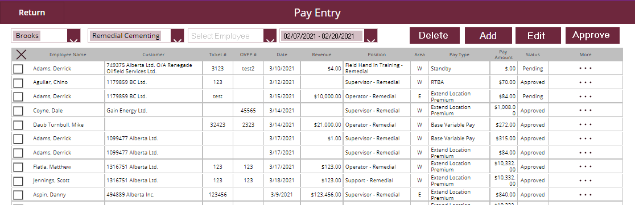
Pay Entry Interface
Employee’s pay entries are listed under the working service point. The working service point is set by carrying over the selected service point in the filter.
Once a work assignment is approved, related pay entries will be calculated automatically based on variable pay rules. All pay entries will be available on the Pay Entry Online Interface.
Working service point DA can enter a pay entry submitted from field employee which is not automated. The entered pay entry can be approved by the manager case by case.
Approved pay entry can be modified by DA, the manager approval process will be triggered.
Pay entry can be deleted by DA, the manager approval process will be triggered.(Not confirmed requirement)
If the pay period summary is cut off, all pay entries within the pay period summary are locked as Cutoff status.
Pay period summary cannot be cut off if any pay entry is not approved underneath.
Move select pay entries to another pay period may be needed upon user’s feedback.

Slide 22
Pay Entry State Machine
Pay Period Summary Open
eService generate new entry
DA enters new entry
Pending (4)
Manager Approval
Approved (8)
DA modified values
Payroll Export ADP
Closed (16)

Slide 23
Pay Period Cut Off Process (Approved Work Activity)
DA Runs Pay Period Cut Off
Jobs
within pay period
Any unapproved job?
Yes
Notify Manger for Job Package Approval
Manager Approve Job Package Process
No
Pay Entries within Pay period
Any unapproved pay entry?
Notify Manger for Pay Entry Approval
Yes
Manager Approve Pay Entry Process
No
Set the Pay Period Summary Cutoff
Manager Approve the Pay Period Summary
Payroll Process
Pay Period Summary
Approved
Pay Period Summary

Slide 24
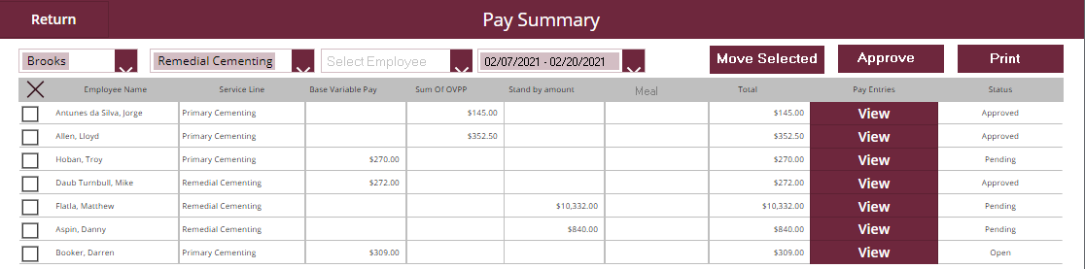
Pay Statement Interface
Pay Statement is updated dynamically while new entries being created until the pay period is cut off.
Pay Statement amounts sum up the employee’s pay entries’ amounts by Pay Summary Type within one pay period.
Pay Statement calculation is home service point based.
Moving Pay Statement from one period to anther can move all pay entries of the employee.
View a pay statement entry can lead user to the pay entry page who filters out all pay entries specifically for the employee.
Once the pay entries of an employee are all approved, the employee’s pay statement status turns pending for approval.
Home Service Point Manager can approve employee’s pay statement for a pay period.
Employee Pay Statement can be printed in batch or individually.

Slide 25
Pay Summary State Machine
Open (1)
System generates per employee per pay period summary
All pay entries are approved
DA modified Pay Entry
Pending (4)
Approved (8)
Payroll Export ADP
Closed (16)
Manager Approval

Slide 26
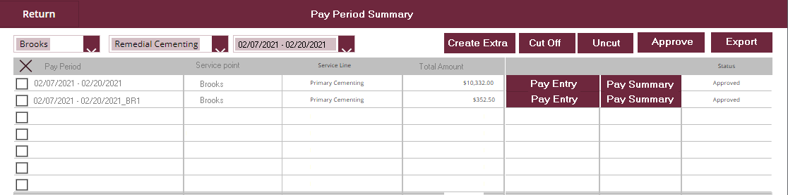
Pay Period Summary Interface
Pay Period Summary List is the landing page for Variable Pay App, user can navigate to pay entry page and pay summary page.
Default Pay Period Summary is created from pay period schedule per service point per service line(?)
Open Pay Period Summary amount is updated dynamically while pay entry is adding.
After all employees’ pay summaries under a pay period are approved, DA can cut off a Pay Period Summary to block adding new pay entries, so the Manager can approve Pay Period Summary. If any employee’s pay entry is not approved, alter will be raised.
DA can create extra Pay Period Summary if default one is cut off or approved already.
DA can uncut an already approved/cutoff Pay Period Summary for entering pay entry purpose. Related Pay Summary needs to be re-approved again.
Payroll Admin can export Payroll summary by earning code and total earning by employee for importing to ADP.
Once the Pay Period Summary is exported, all pay entries underneath are not able to re-open for modification..

Slide 27
Pay Period Summary State Machine
System creates default
DA Cutoff Pay Period Summary
Cutoff (2)
Open (1)
DA Uncut Pay Period
All pay summaries are approved
DA modified Pay Entry
DA creates extra
Pending (4)
Manager Approval
Approved (8)
Payroll Export ADP
Closed (16)

Slide 28
Other Topics
Meal is missing in pay summary.
Sharepoint list purge after closed pay period data transferred back to database.

Slide 29
Additional Rules Clarified
Operations Engineer and Field Engineer are paid in explicitpay positions.
Technically the engineer, while on location, can perform many different duties. Possible even act as on operator or supervisor, But Susie said, whatever they do, they are paid the Engineering bonus,

